Slide 1


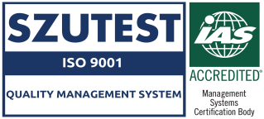




Half Man Engineering was established in 1980 single handedly by Its Owner MR. MUHAMMAD AQIL (LATE). Now Half Man is one of the leading automotive Sheet metal component manufacturers in Pakistan and the Pioneer part supplier of OEM’s. The company is supplying top quality Auto Parts for Cars & Trucks. We have robust press shop, welding shop and die shop. Almost have 40 years of manufacturing experience. in, blanking stamping draw, forming, piercing trimming, and die/CF designing / manufacturing according to CAD data of sheet metal parts. Half Man Engineering is the registered supplier of different OEMs like: M/S. Pak Suzuki Motors co., .M/S. F.A.W., M/S Hino Pak, NDC, Agriautos stamping company PVT, Agriauto Industries Limited, Procon Engineering, KIA Lucky Motors Corporation, Dawood Engineering Pvt Ltd .
Halfman wants to become a leading vendor for almost all OEMs
Our mission is to provide premium quality to our valuable customers
We plan to adopt new technology and develop our skills and expertise in the field of dies and fixture designing and manufacturing and enhance inspection facilities as well as in fabrication projects.

Slide 2

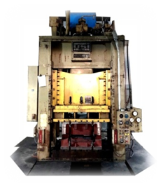


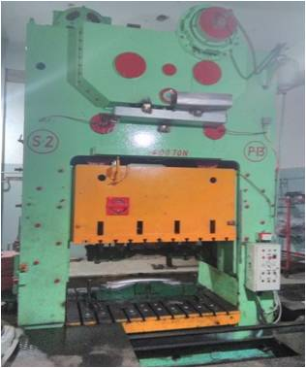
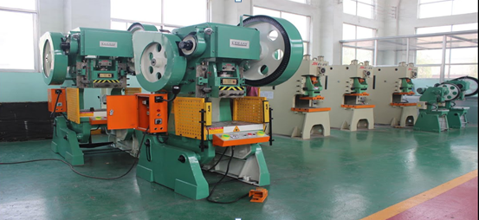
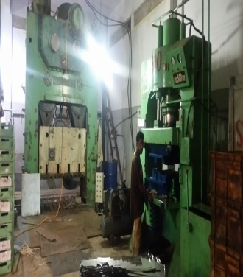
We have a robust press shop well equipped with presses of various capacities and types including England made and local. Press shop is main strength of our production department. Our shearing section is also include in press shop. List of presses and shearing machine is as follow.
300 Ton-No Of Press-1
150 Ton-No Of Press-2
100 Ton-No Of Press-1
200 Ton-No Of Press-4
100 Ton-No Of Press-3
70 Ton-No Of Press-3
50 Ton-No Of Press-2
20 Ton-No Of Press-2
10 Ton-No Of Press-2
400 Ton-No Of Press-1
200 Ton-No Of Press-1

Slide 3

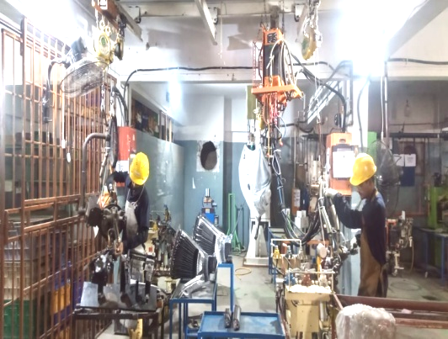

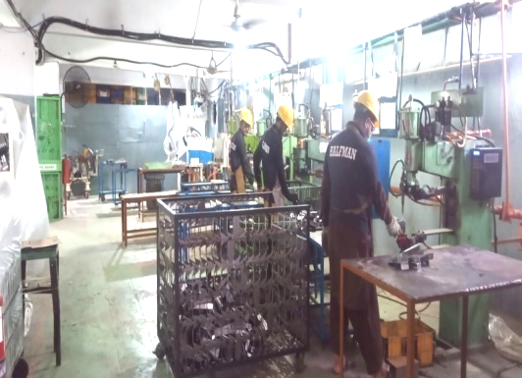
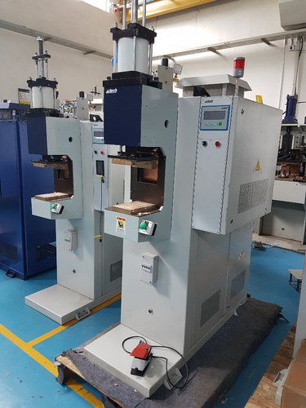
Our welding shop is very important shop as those parts which have sub parts, and accessories are spot /GMAW welded here. We have 3 common types of welding facilities i.e. spot welding, GMAW, SMAW. Our Welding shop consists of.
GMAW (200 ∼ 300amp) - 03 NOS.
PLC Spot Welding Fixed Type (35kva) -05 NOS.
Portable Spot Gun (30kva) -01 NO.
Buffing / Polishing Machine

Slide 4


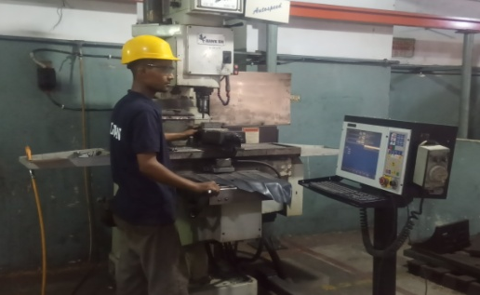
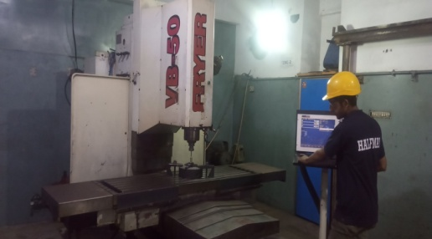
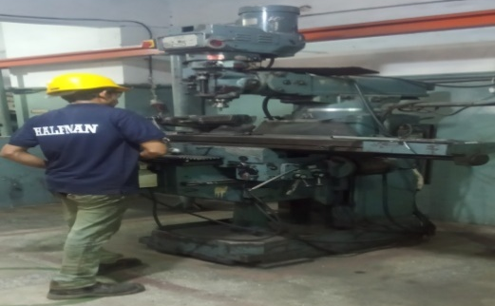


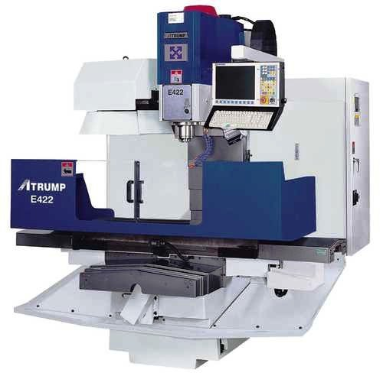
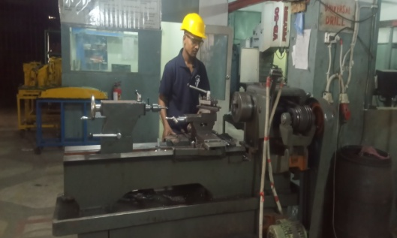
Half mane has state of the art die making facilities. We have the capability to design and manufacture dies and checking fixtures according to CAD data. In addition to die manufacturing, old dies are inspected regularly and maintenance work is carried out whenever required.
Our tool and die shop consists of.
CNC Milling Machine Made in Taiwan (750x450x300)
CNC Extron Milling Machine Made in Taiwan (1050x550x650)
CNC machine Center Maker FRYER- Made in USA (1200x750x650)
Lathe Machine
Shaper
Milling Machine
Drilling Machine
Disc Grinder
Pin Grinder
Disc Cutter
Tool Grinder
Arc Welding Plant
Gas Cutter
Wire Cut
Heat Treatment
Paint
Powder Coating
Galvanizing

Slide 5






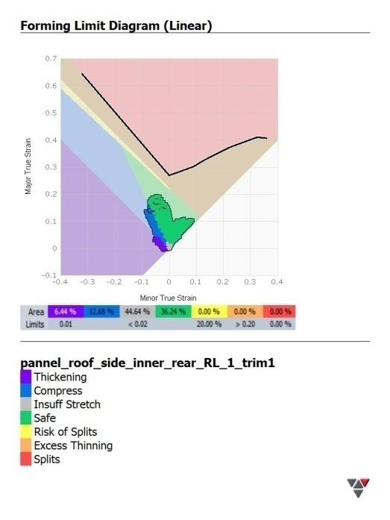
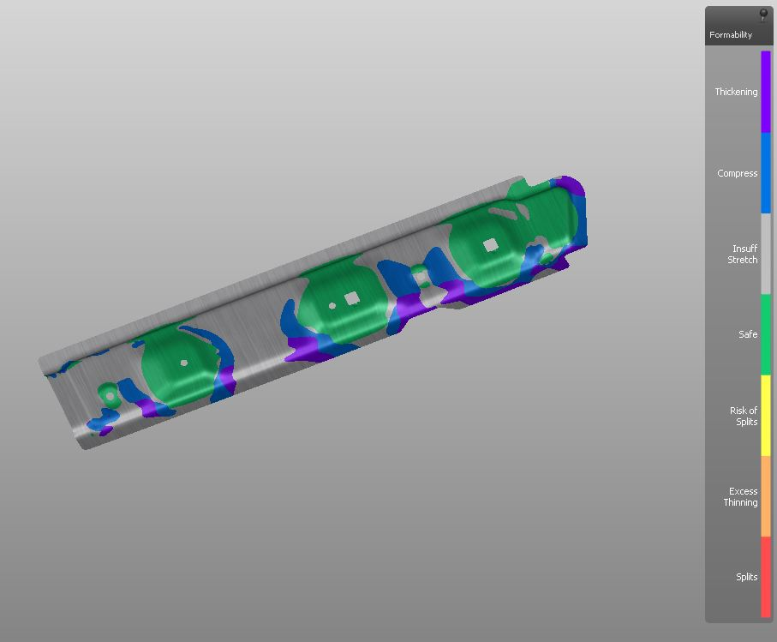
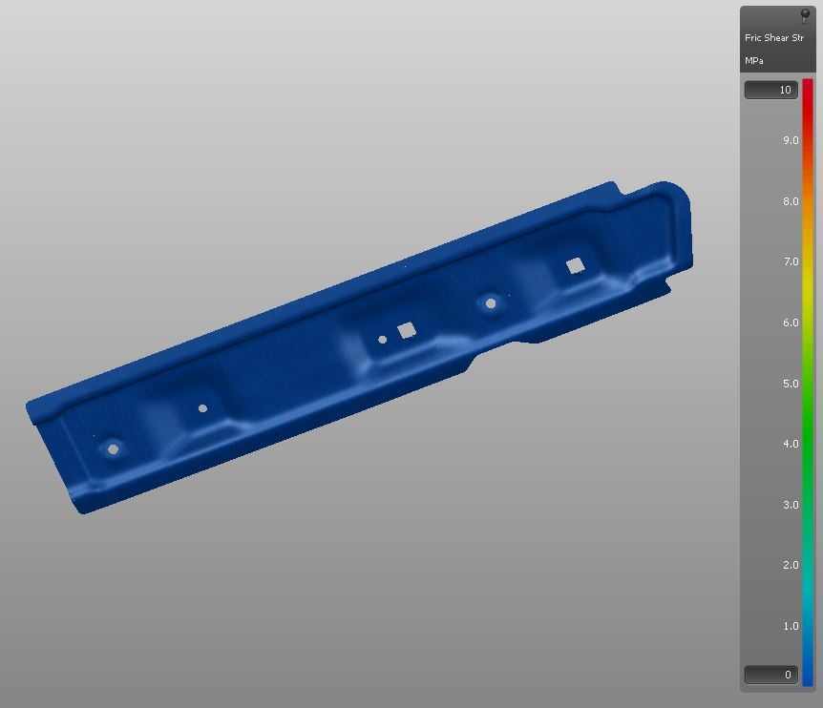
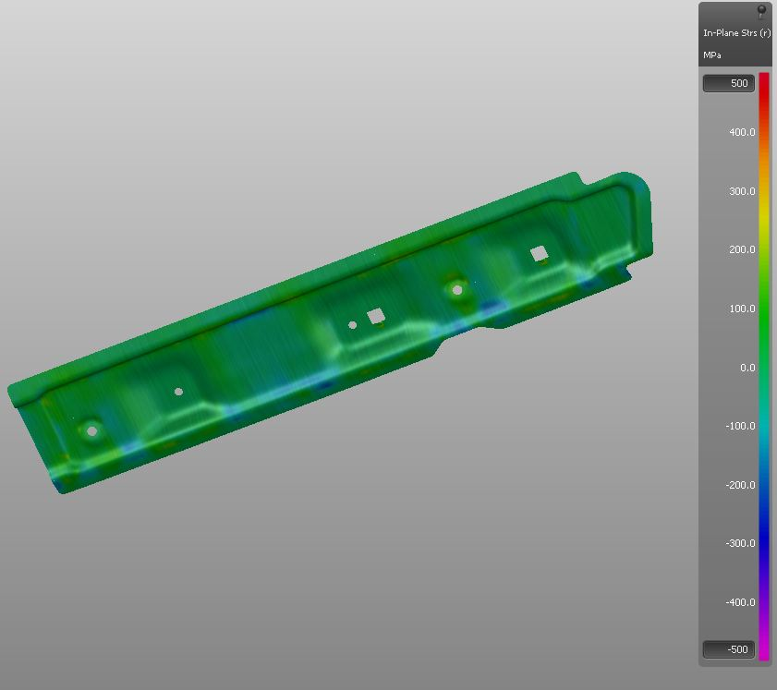

Now we are providing following services.
Designing (AUTO CAD, CREO, AUTO FORM & CATIA)
Jigs & Fixtures Development
Tool & Die Development
Trollies and Bin’s Fabrication
General Fabrication

Slide 6




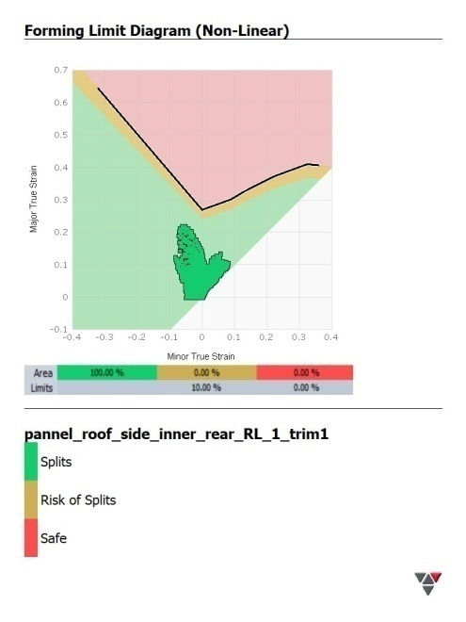
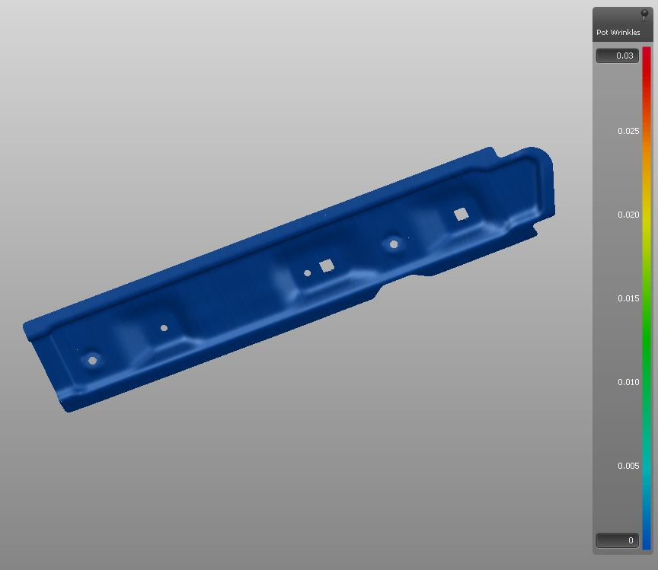
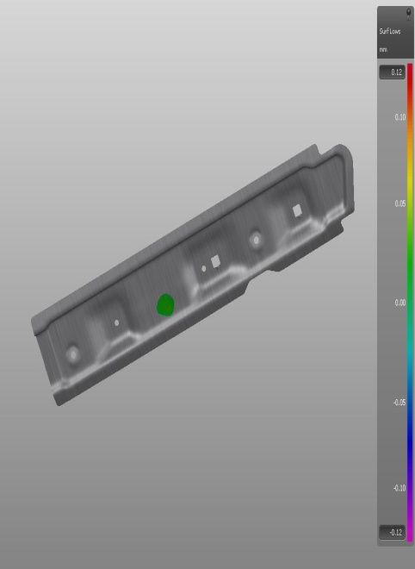



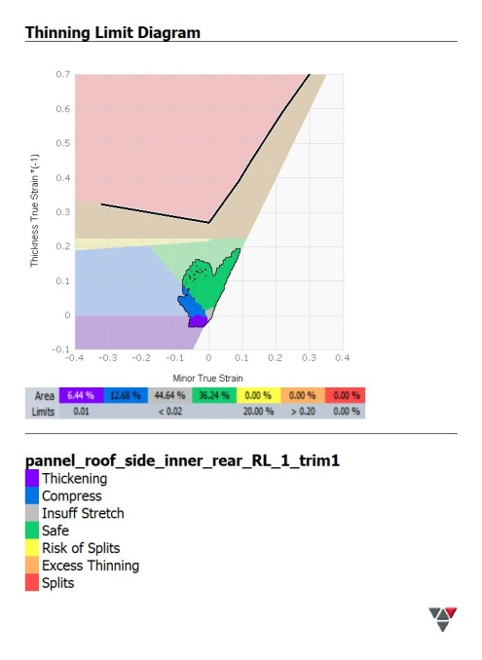
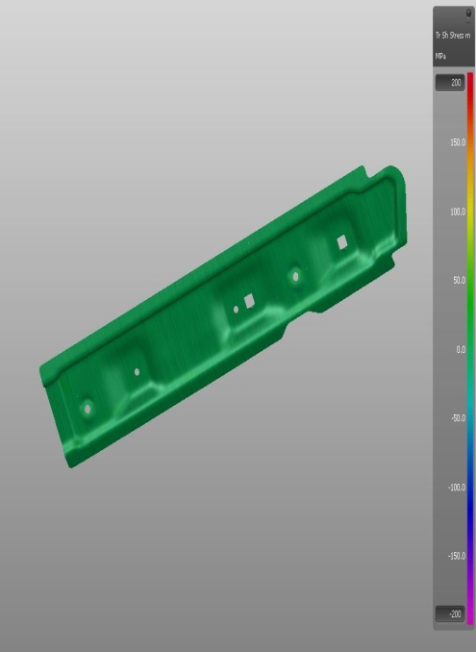
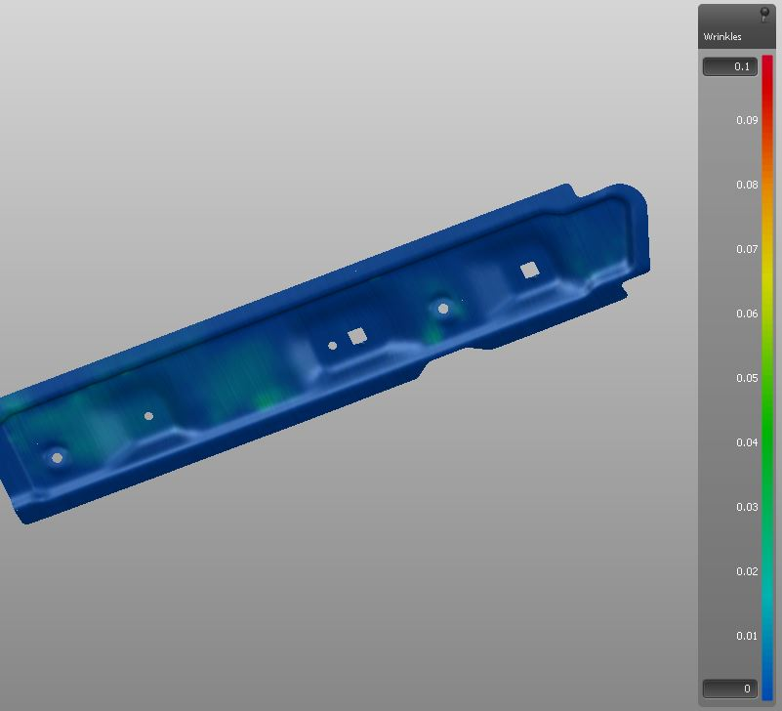

Slide 7

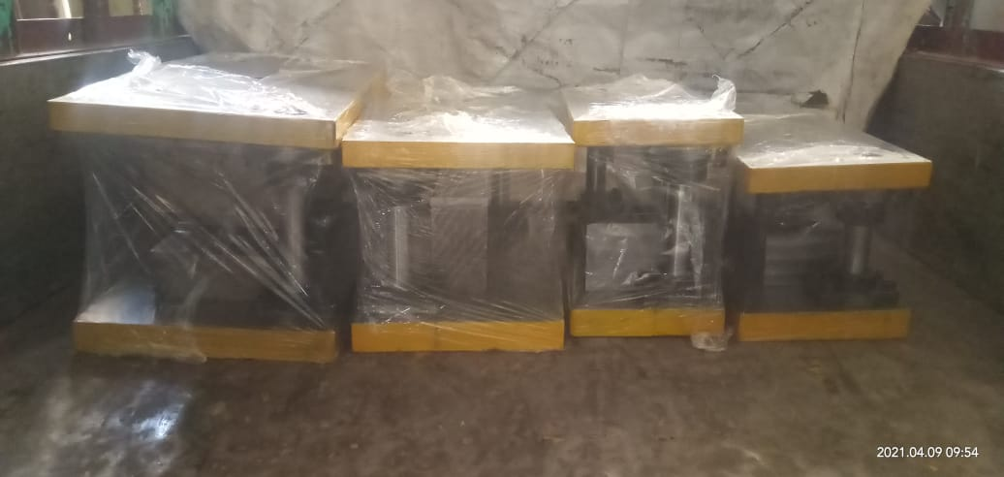
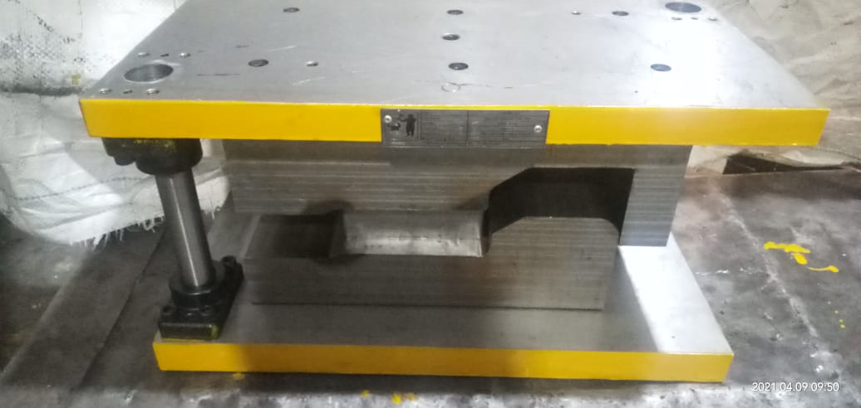
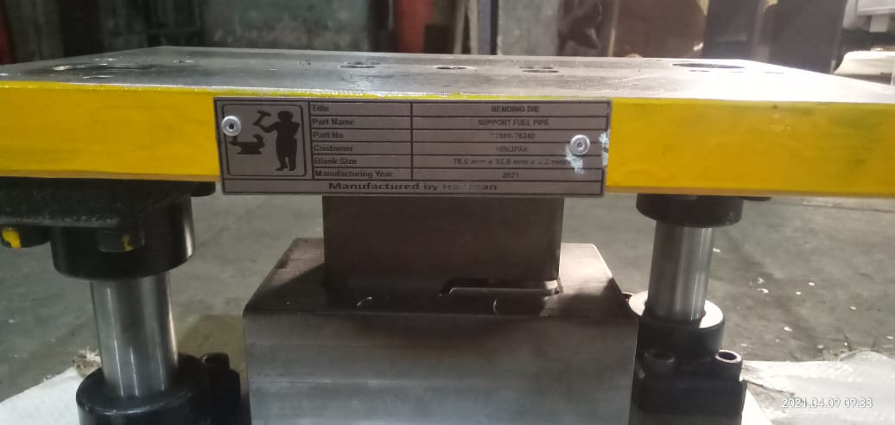

Slide 8

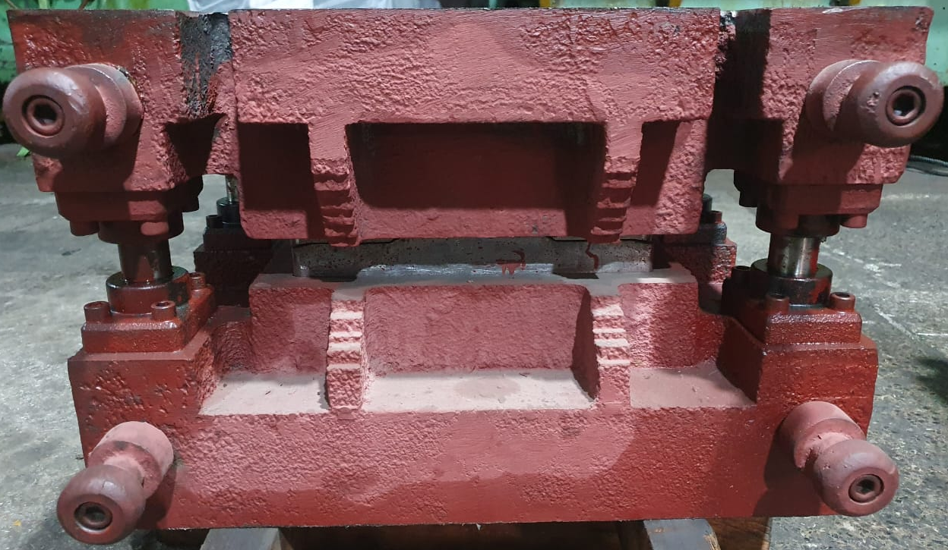
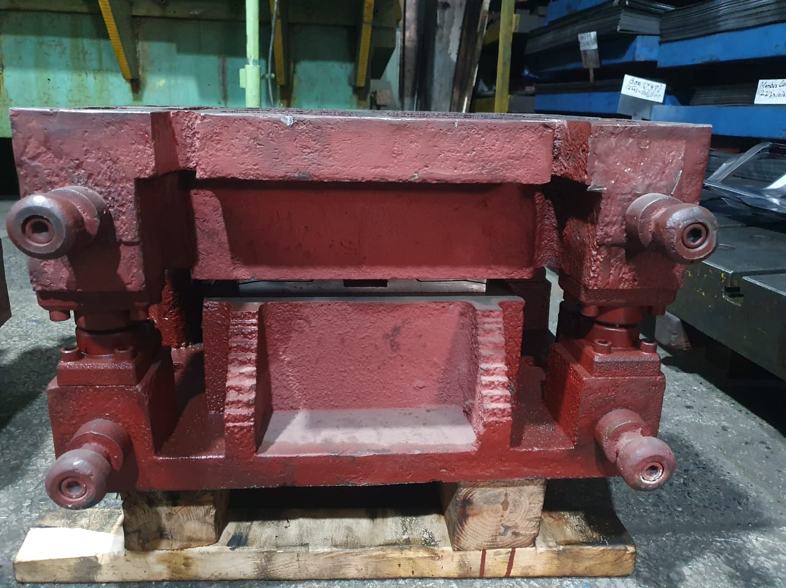
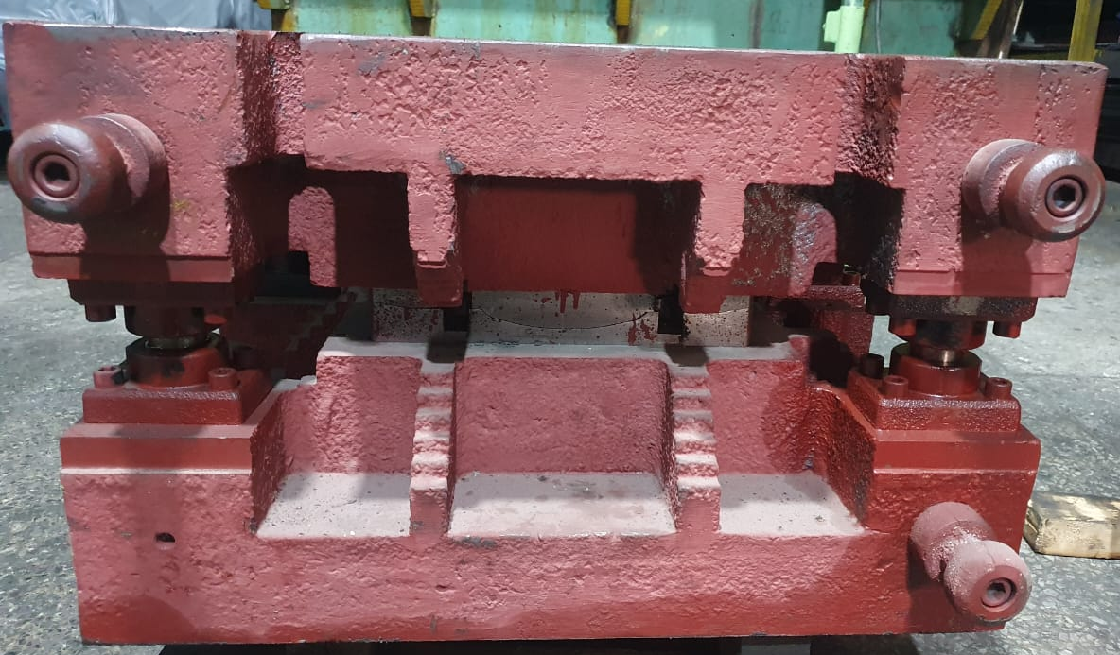
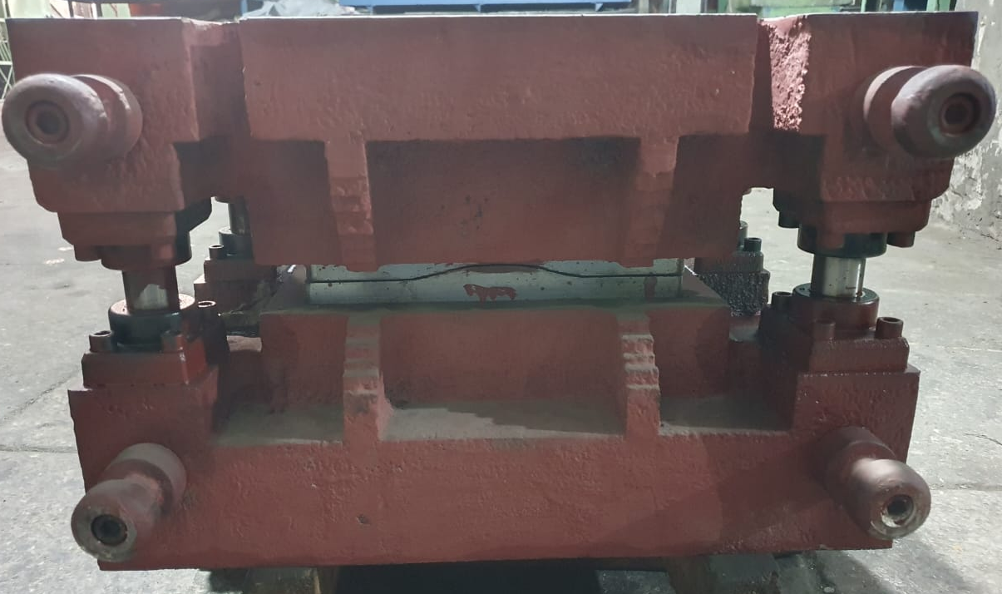

Slide 9

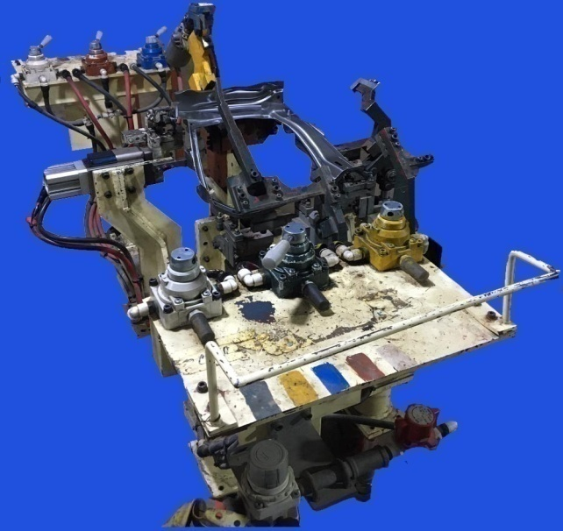
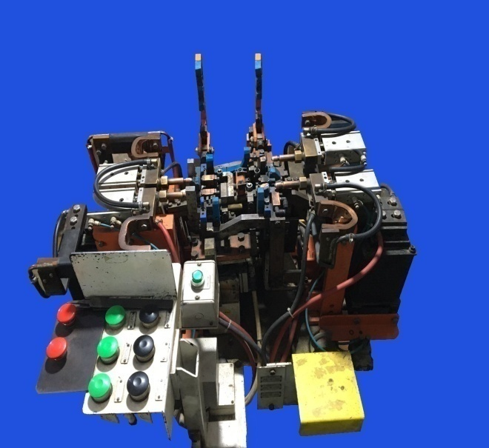
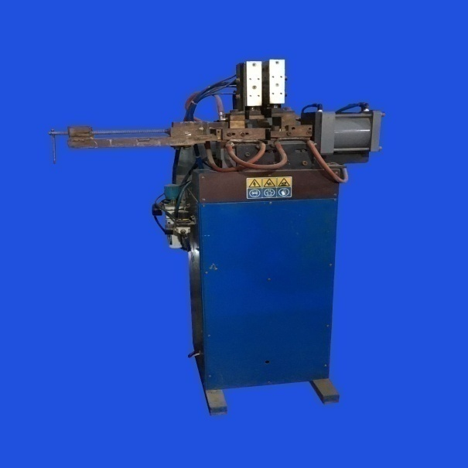
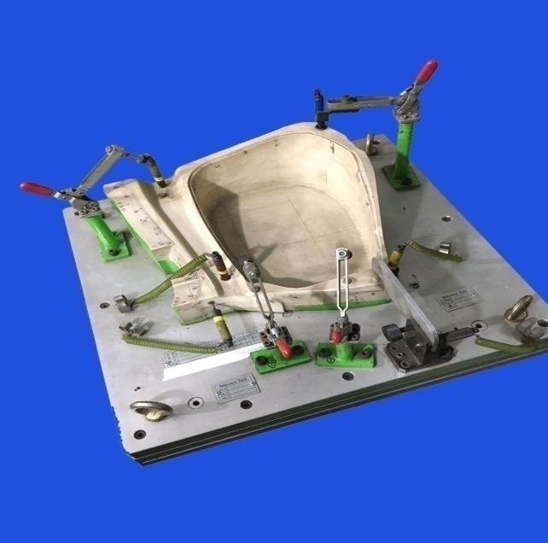
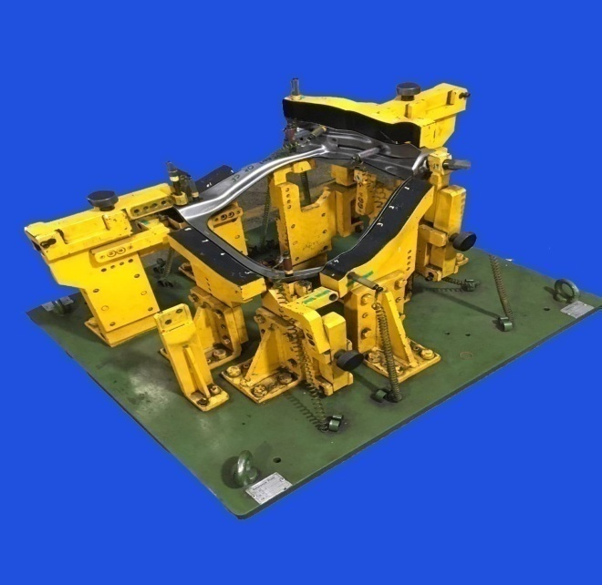
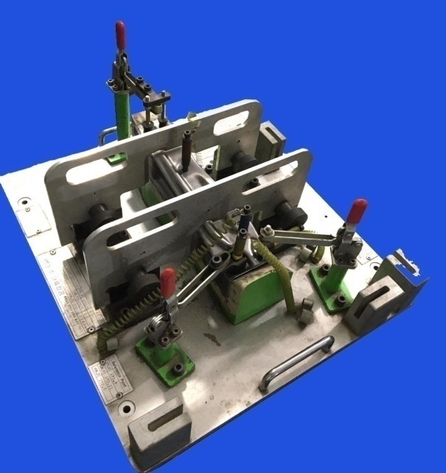

Slide 10
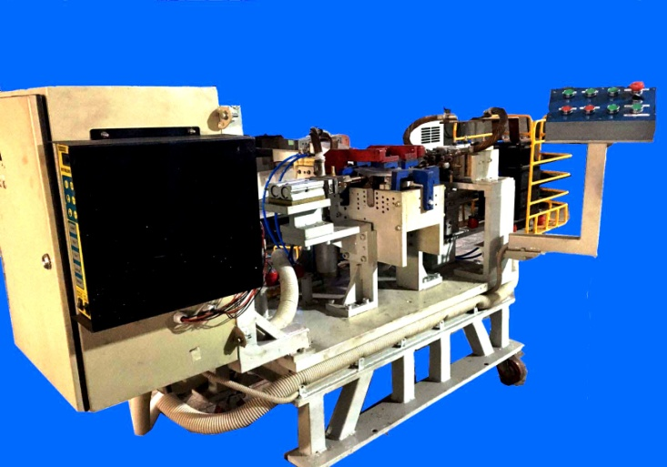
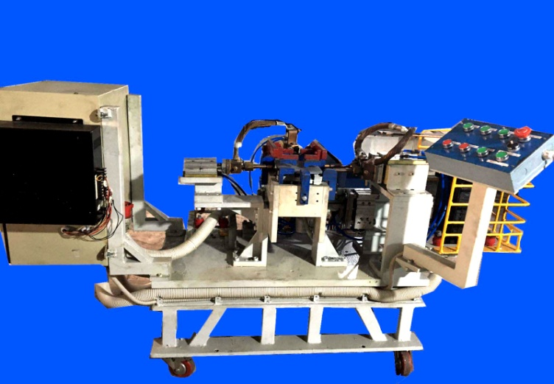
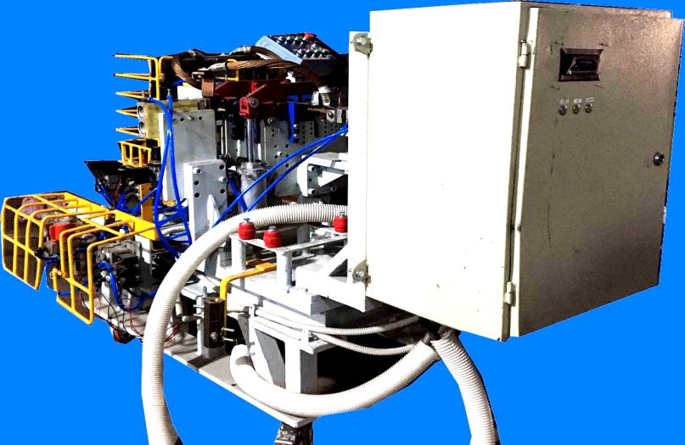

Slide 11
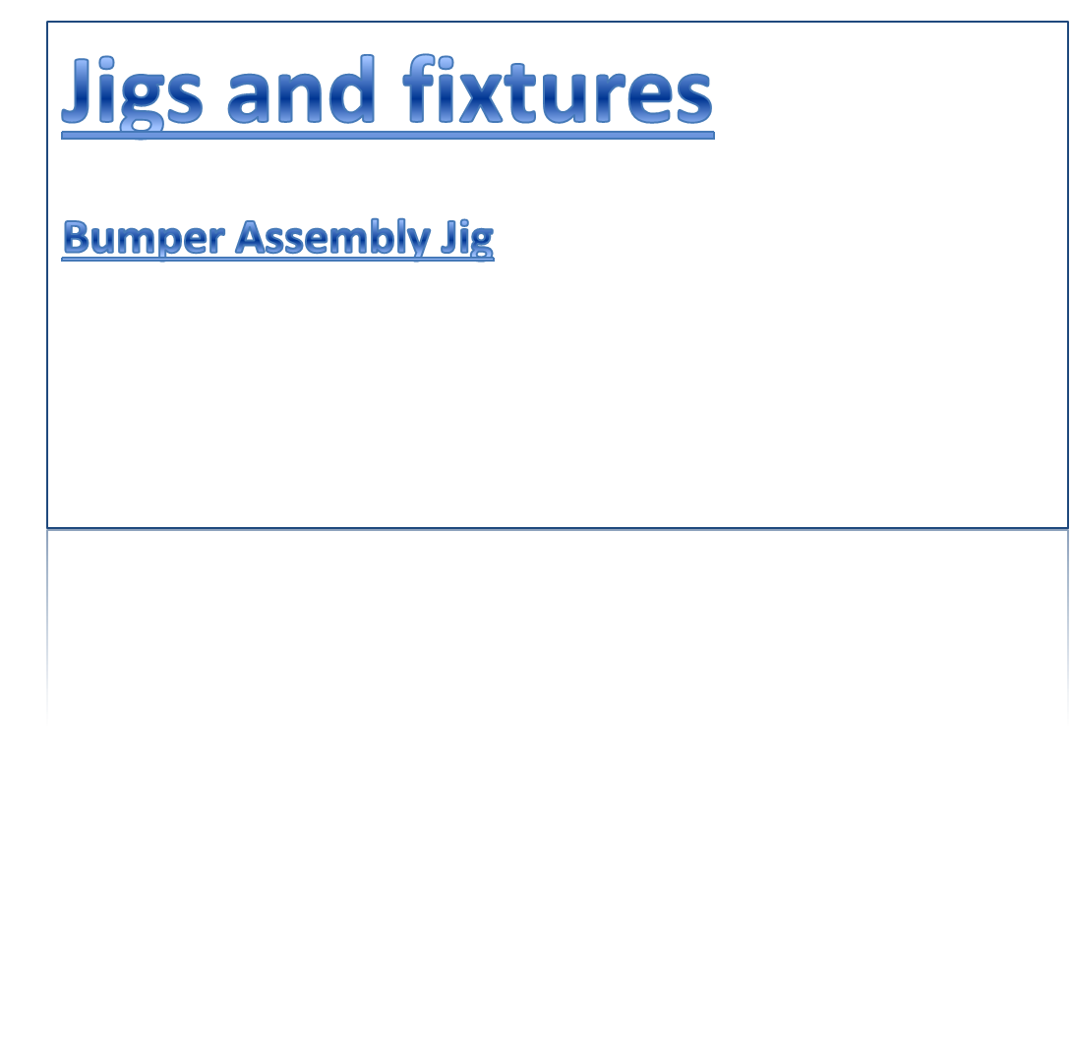
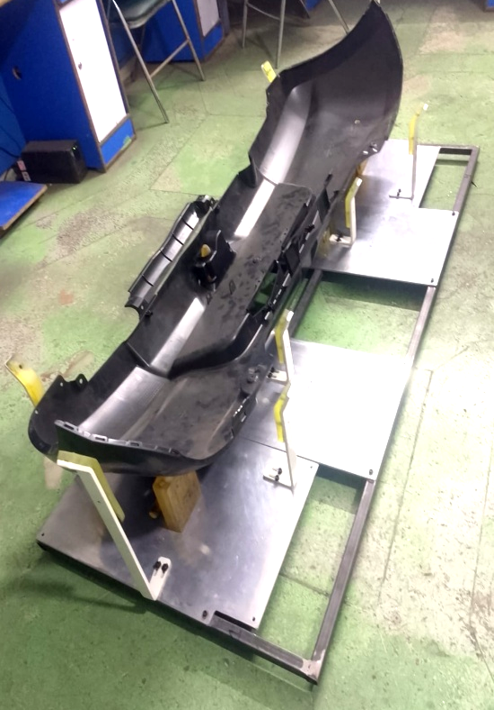
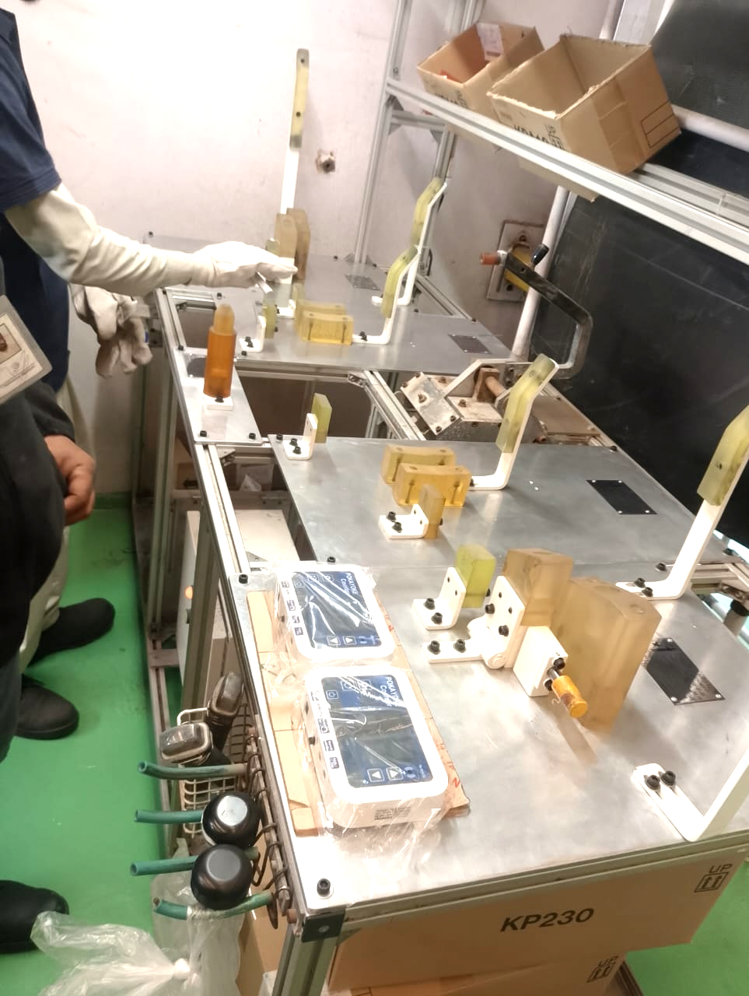
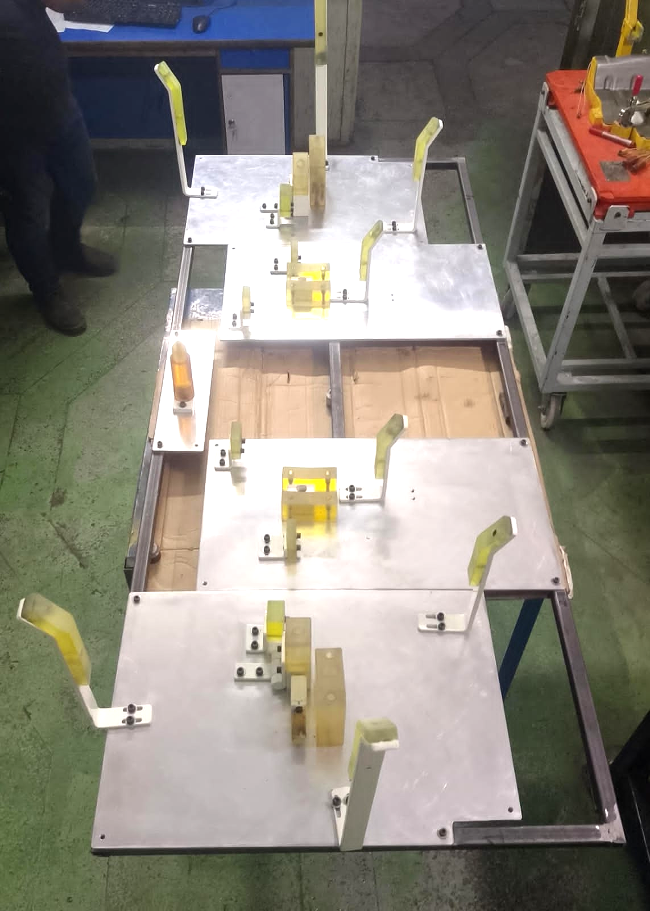

Slide 12
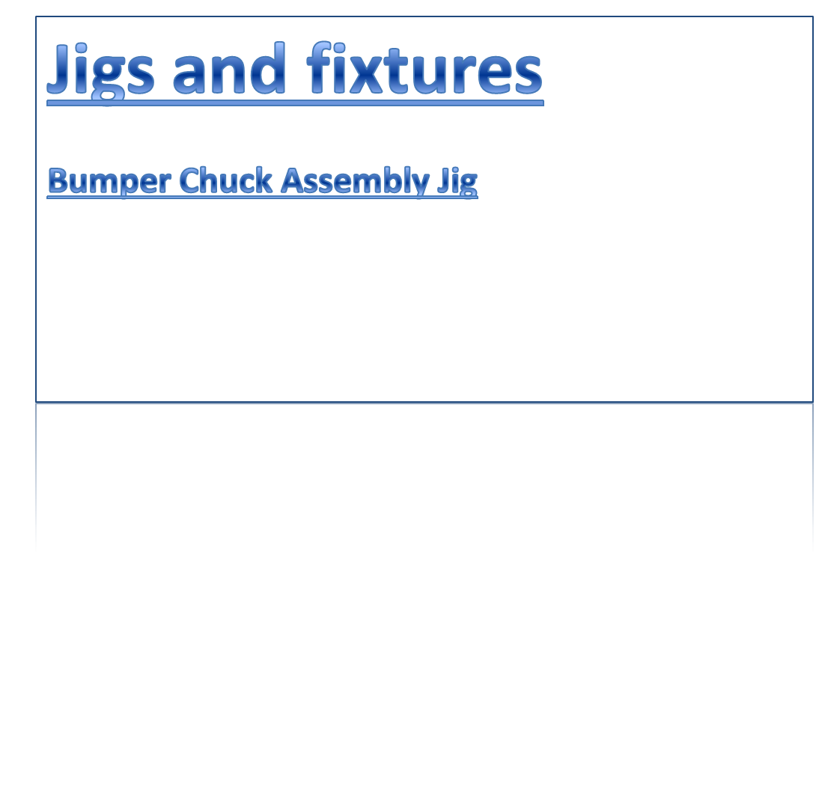
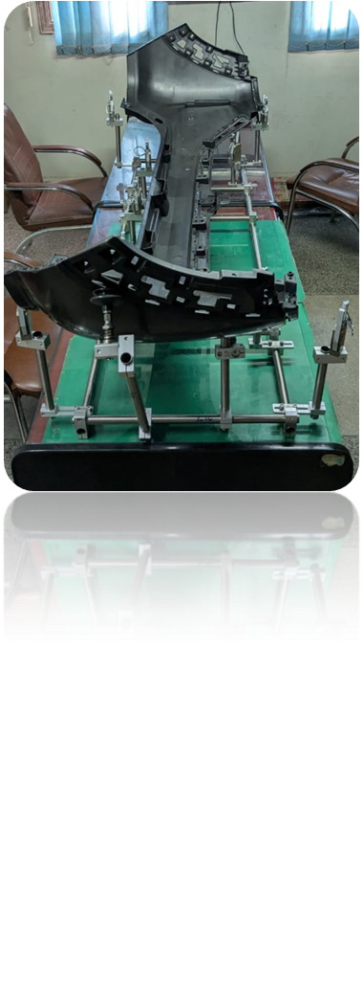
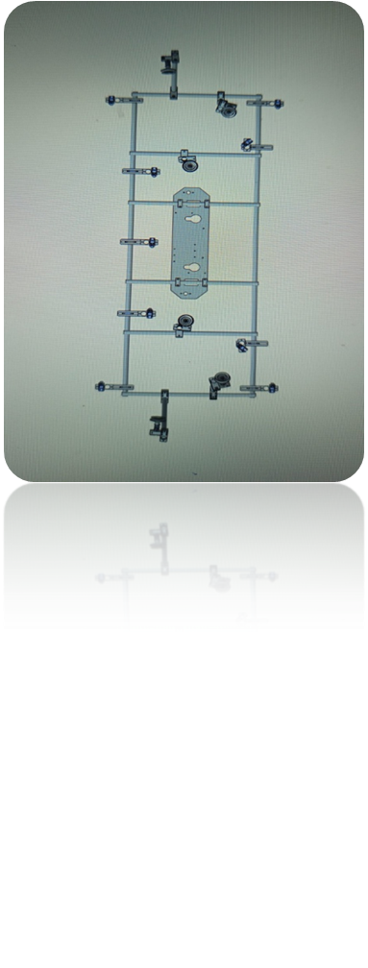
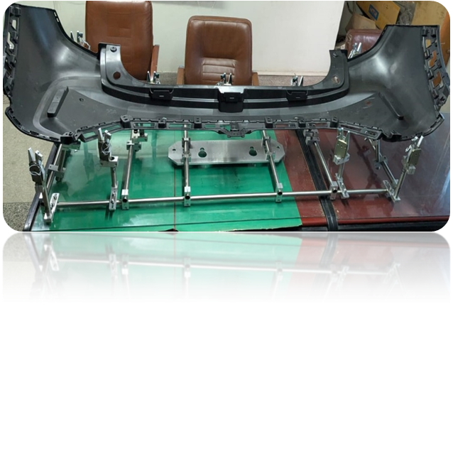

Slide 14

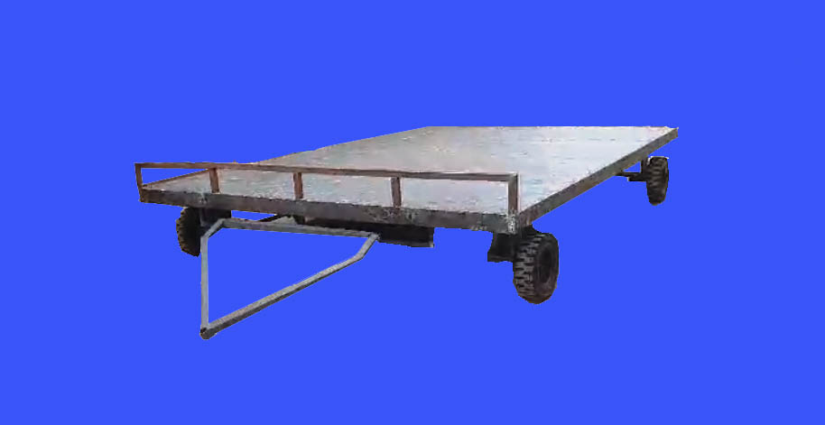
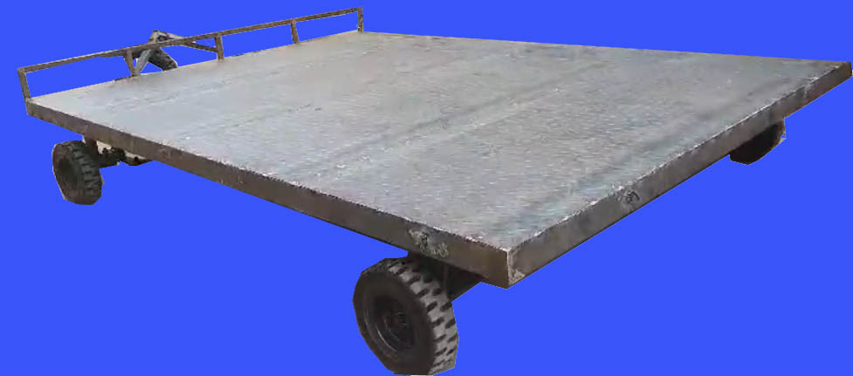

Slide 15

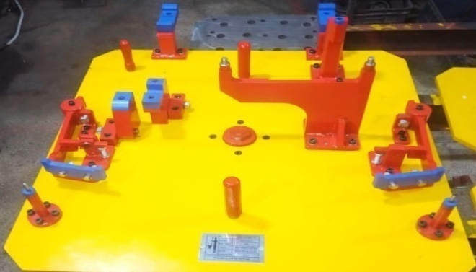



Front Sub Pallet
Rear Sub Pallet

Slide 16







In line with our policy of continual improvement Halfman is continuously increasing equipment and skill of employees, lead by its owner according to the requirements of OEMs. Halfman is well equipped with instruments.
Force Gauge
Ampere Metter
Tip dresser
Plug gauge (6m ~ 8m)
Thickness Tester
Hardness Tester
Surface table
Magnetic block
Digital Vernier Caliper
Micro Meter
Micro meter pin – flat
Height Gauge
Digital Dial Gauge
Digital Weighing Scale
Dove tail
Feeler Gauge
Taper Gauge
Our effort and expertise are acknowledged by OEMs and almost regularly Halfman awarded by PSMC annually for its performance in quality, development and in time delivery of parts according to schedules.

Slide 17










Panel Comp Back Plr Lower R/L
Reinf , Comp Pedal Brkt R
Member Dash Side R/L
Junction Switch
Reinf, Rear Door Inner Front RL
Reinf,Pedal Brkt L
Lid Comp Fuel Inlet
Panel Roof Side Inner Rear R/L

Slide 18












Hanger Comp Rear Spring Front Model STR
Member Service Hole CTR Model STR
BRKT Comp. Fuel Tank Rear R Model STR
BRKT Comp. Roof Inner Model STV
BRKT Fuel Filter / Pump Model STR
Reinf Back Door Hinge. L Model YR-
Reinf, RR Seat Belt Side. R Model YR-9
Reinf, RR Seat Belt Side. L Model YR-9
BRKT Fuel Pipe Clamp Model STR
BRKT Roof RIENF Model STV
Reinf, RR Seat Belt CTR Model YR-9

Slide 19













Reinf Front Hood Hinge Model YR-9
R/F Comp RR PLR CTR.L Model STV
Reinf Side Door Hinge Model YR-9
Box Fuel Inlet Model YR-9
Hanger Comp. Pedal BRKT Model YR-9
Hanger Comp. Rear Spring Rear Model STR
Reinf Back Door Hinge. R Model YR-9
R/F Comp RR PLR CTR.R Model STV
Stiffener, Steering Column BRKT Model YR-9
BRKT CPRS Model YR-9/YLA
Model YR-9/YLA Model YN-3/YLA
Hanger Comp Pedal BRKT Model YN3

Slide 20












Hanger Comp Rear Spring Rear Model STV
Hanger Muffler Model STV
Plate Oil Pan Baffle Model YR-9/YLA
Adjuster Gen. Belt Model YR-9
ARM Gen. Belt ADJ Model YR-9
BRKT Front Flexible Hose. L Model STV/R
Striker Comp RR Seat Back Lock Model SB/308
Panel Radiator Cover Upper Model STV/R
Rod Comp RR Door In. Lock.R/L Model SB/308
BRKT Front Flexible Hose.R Model STV/R
BRKT Rear Mount (Engine) Model STV/R
Plate Fuel Pump Model STV

Slide 21











Member Tail End Model YLA
Member Cowl Side Outer. R Model YLA
Member Cowl Side Outer. L Model YLA
Reinf Comp Glove Box Upper Model: YLA
Brace Comp, Lamp Support R&L Model : Y4J
Box Fuel Inlet Model: Y4J
Lid comp, Fuel Inlet Model : Y4J
Gutter Comp, Input Oil Model: Y4J
Bracket, Front Fender Upper R & L Model: Y4J
Bracket, Front Fender Lower R & L Model: Y4J

Slide 22






BRKT Tail Pipe Model STR
Rail FR DR Trim Model STV/R
Extension Comp Side Body OTR.R Model YLA
Extension Comp Side Body OTR.L Model YLA
Box fuel filler Model: YLA
Stabilizer Link

Slide 23








Top cover beam assembly Model: van
Rear engine supprorting bracket
Model: van
Stay Step Model: FG1-JT
New Developed parts

Slide 24

.SRO-655(I)/2006 we are importing some material from South Korea.
JAC 270CN
JSH 270CN-P
JSC 270EN
JSH 270DN
JSH 270CEN
SPHC-P
SPCC
SPH 38
SECC NS 20/20
JAC 270CN 45/45
JSC 270CC
SPCG 440
SS 400

Slide 25








Pak Suzuki
Dawood Engineering
Hino Pak
Faw Motors
KIA Lucky Motor Corporation
NDC
National Development Complex
Agriautos Stamping Company PVT
Agriautos Industries Limited
Procon Engineering

Slide 26









Fork Lifter
Hoist Crane
Tool Grinder
Air Compressor
Cooling Tower
Tip Dresser
Standby Generator
Cargo Lift

Slide 27




ISO:9001-2015
Membership Certificate

Slide 28




(The Pakistan Association of Automotive Parts & Accessories Manufacturers)
(Karachi Chamber of Commerce & Industry)
(Engineering Development Board)

Slide 29








Slide 30







Slide 31







Slide 32


Address: Plot No. C-I/60-62, Sector 12-C, North Karachi Industrial Area, Karachi, Pakistan.
Tel: +92 21 36963158 – 59
Cell: +92 334 3204047
Email: info@ halfmanengineering.com

